Slide 1
Scooter city
A new era in human transportation
A study on the effect of crime rate due to the introduction of dockless motorized scooters

Slide 2
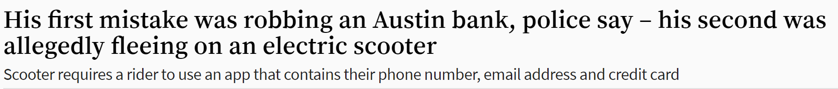
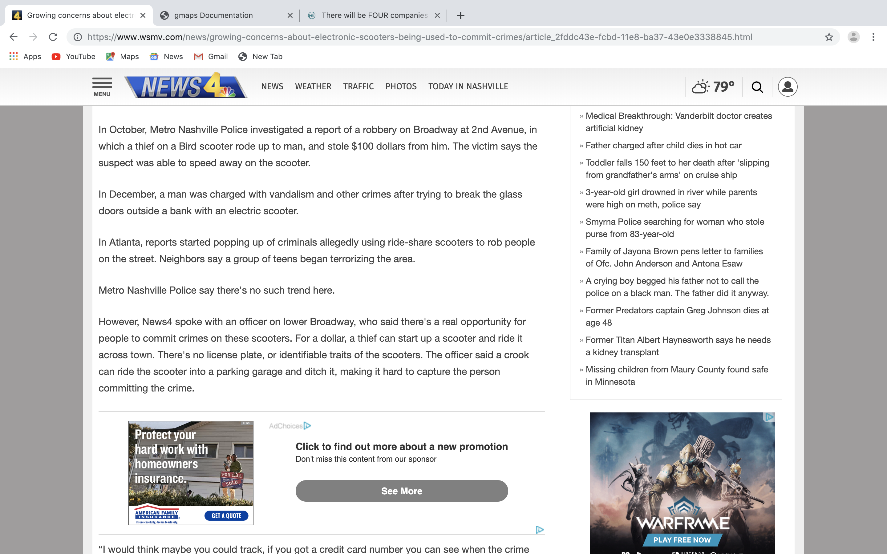
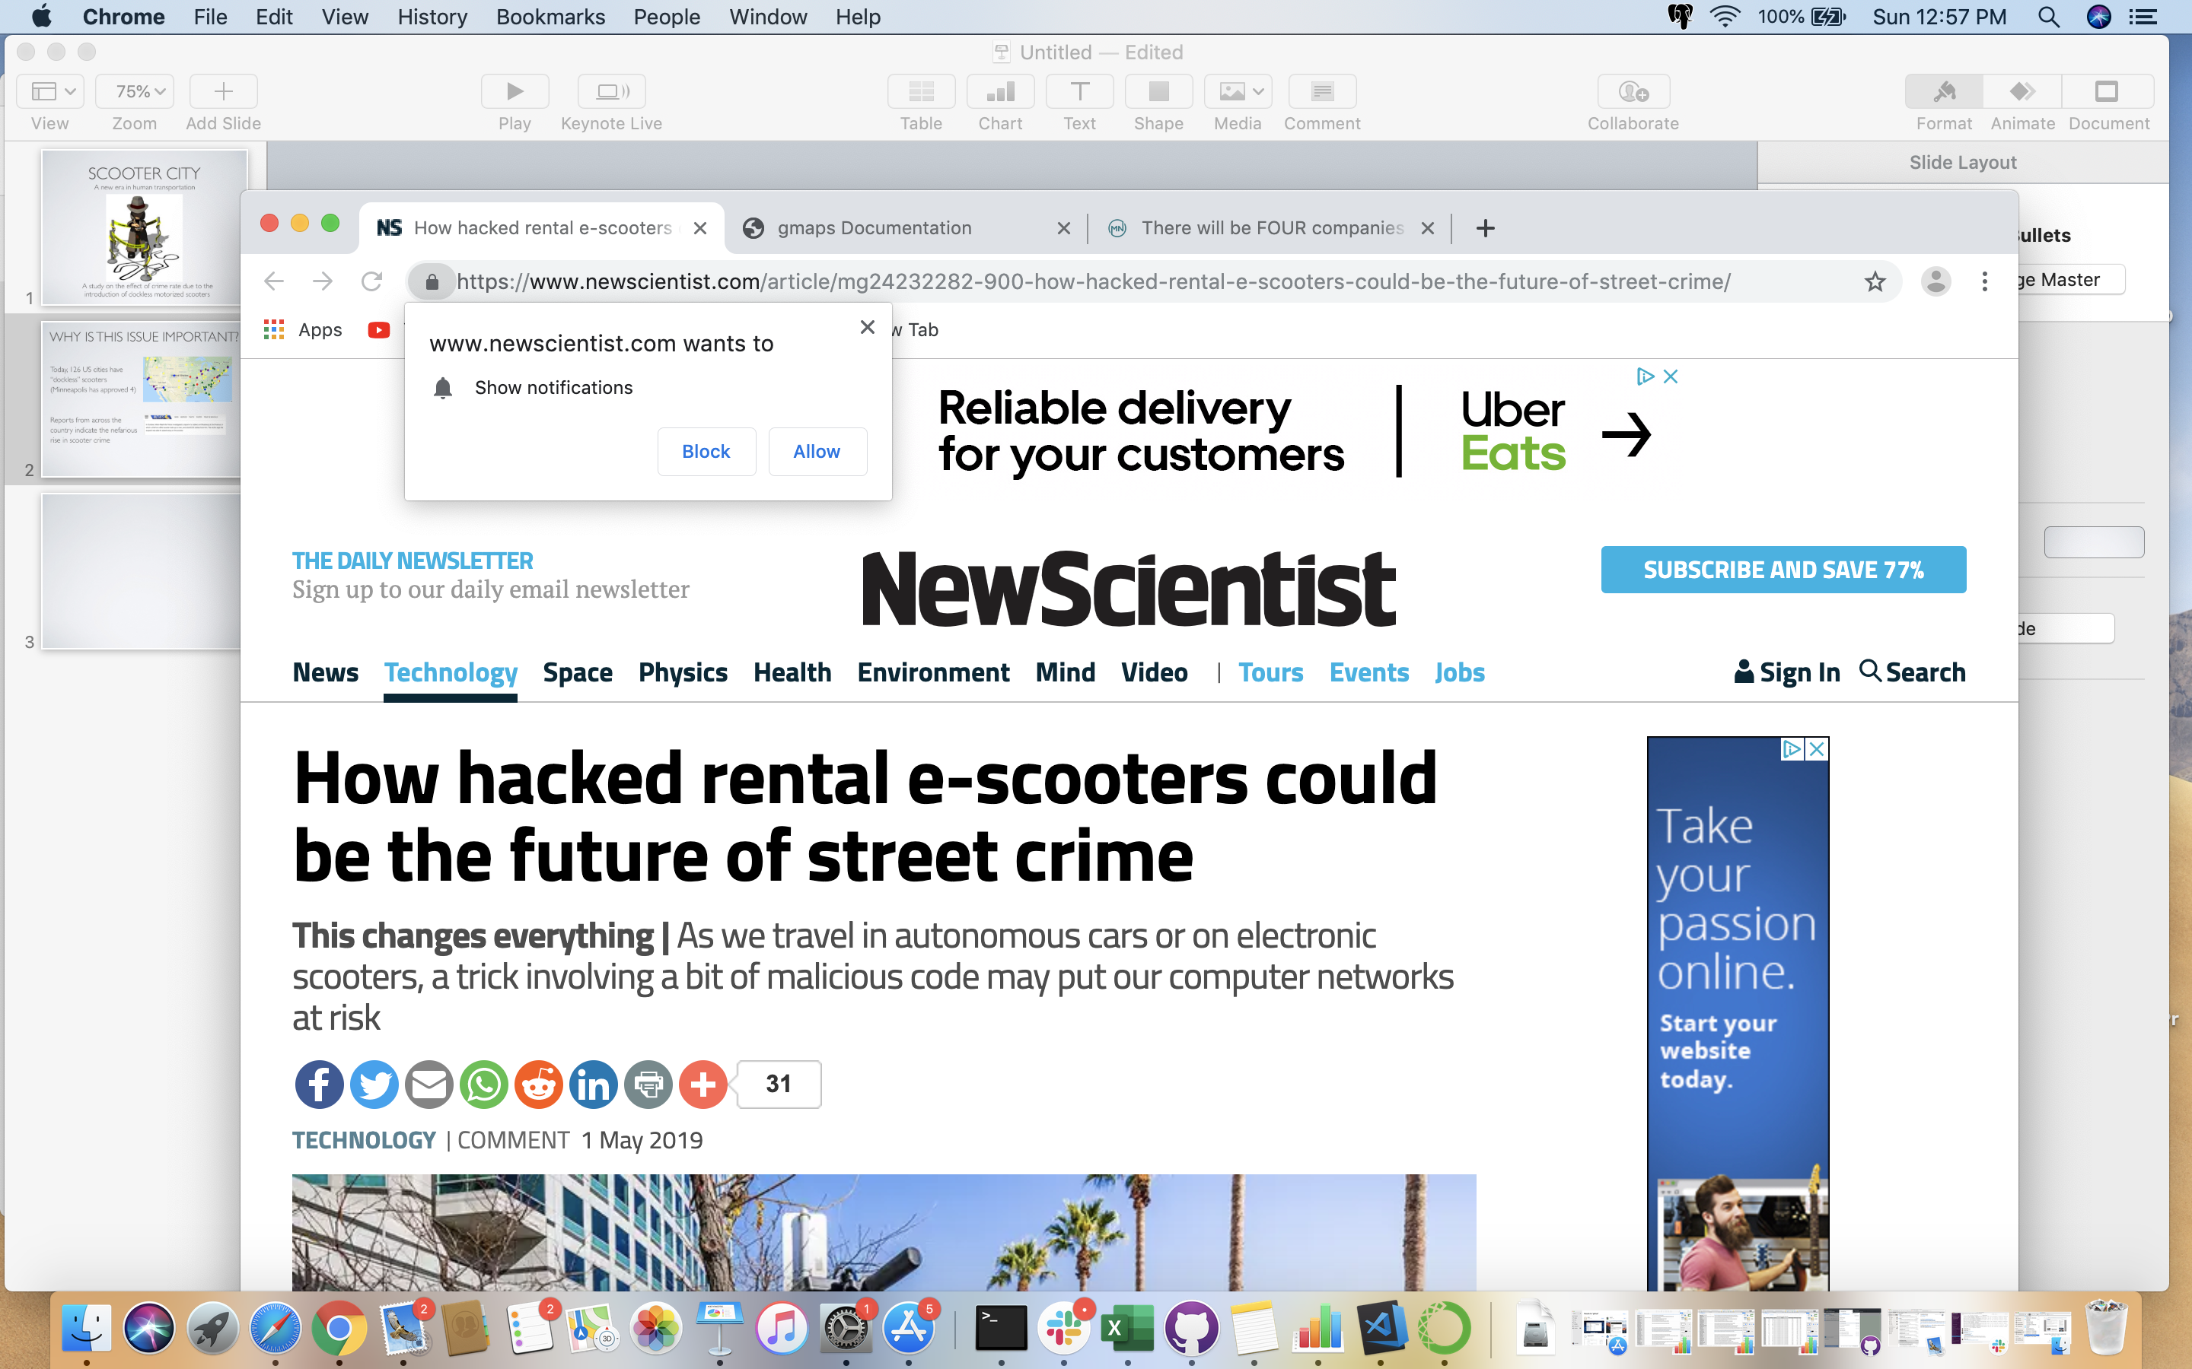
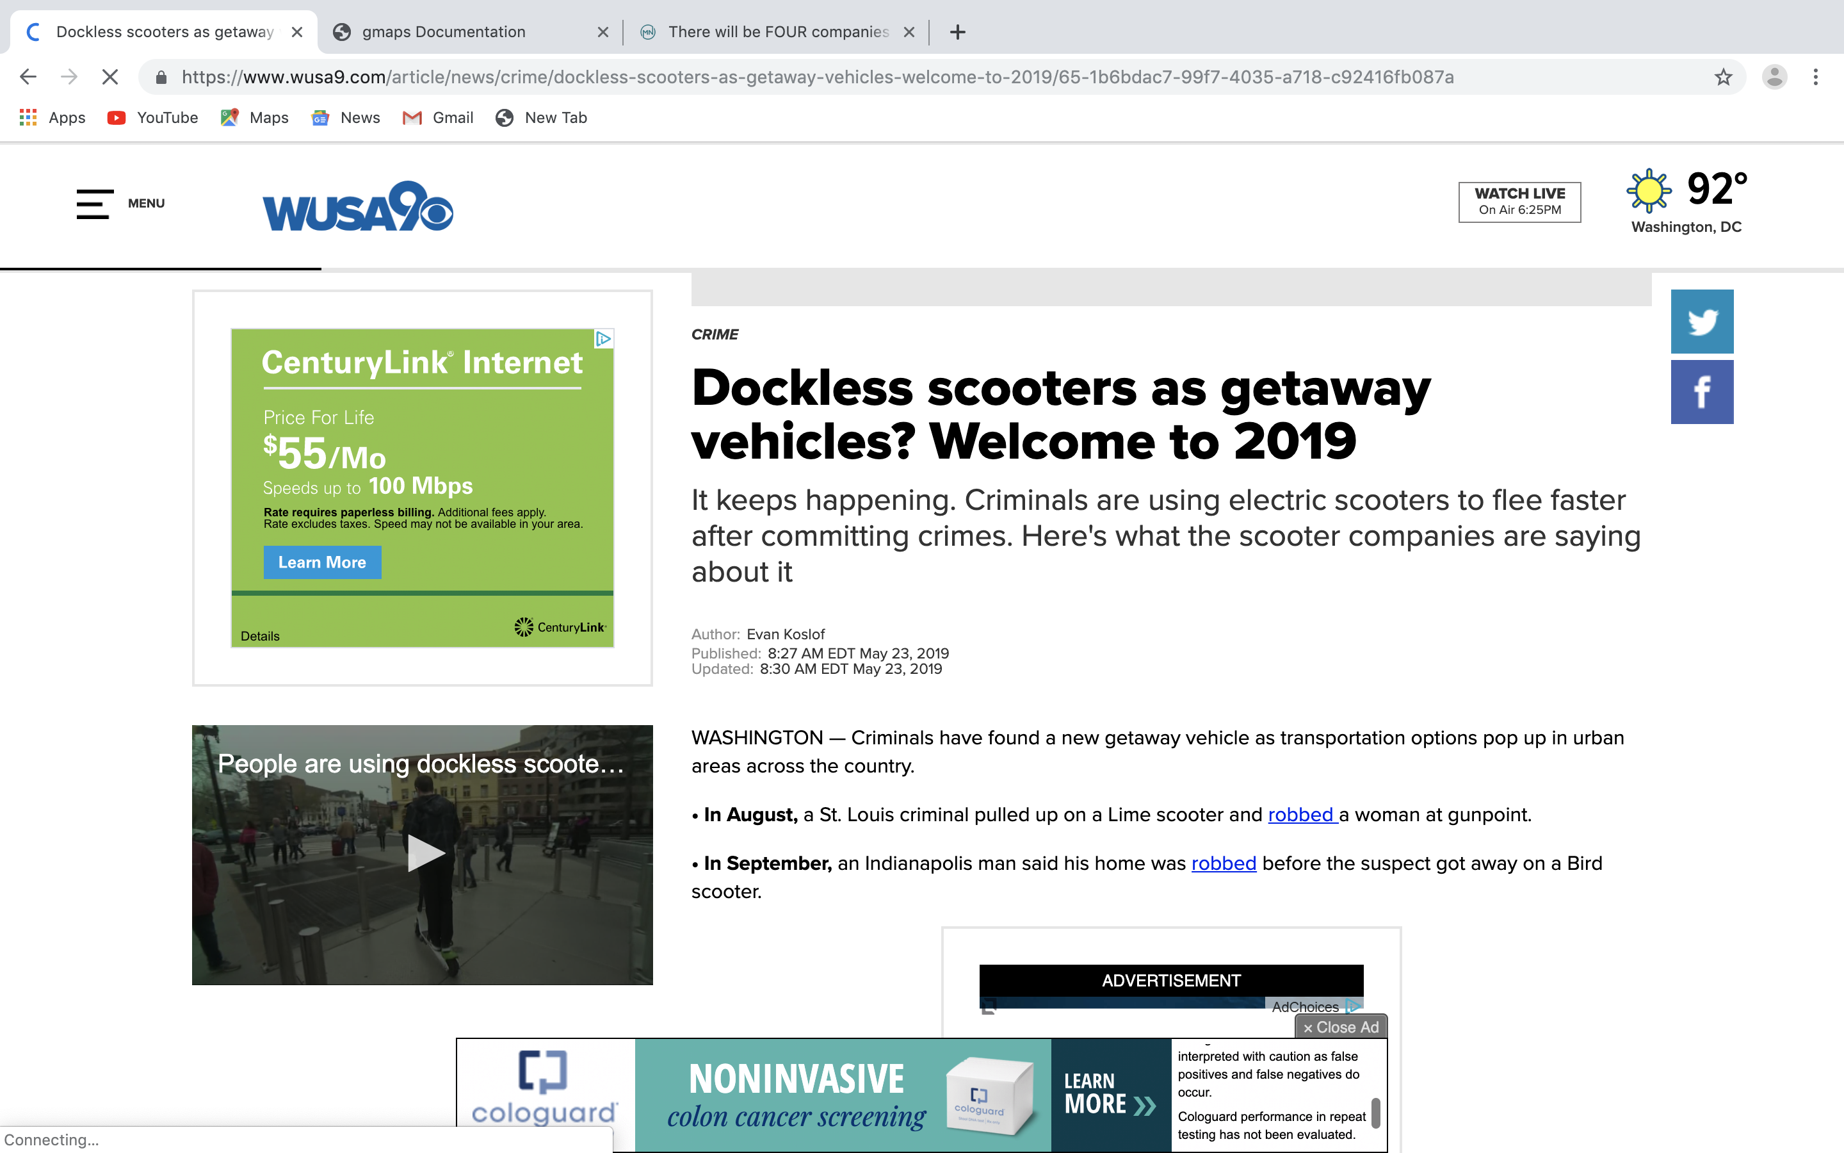
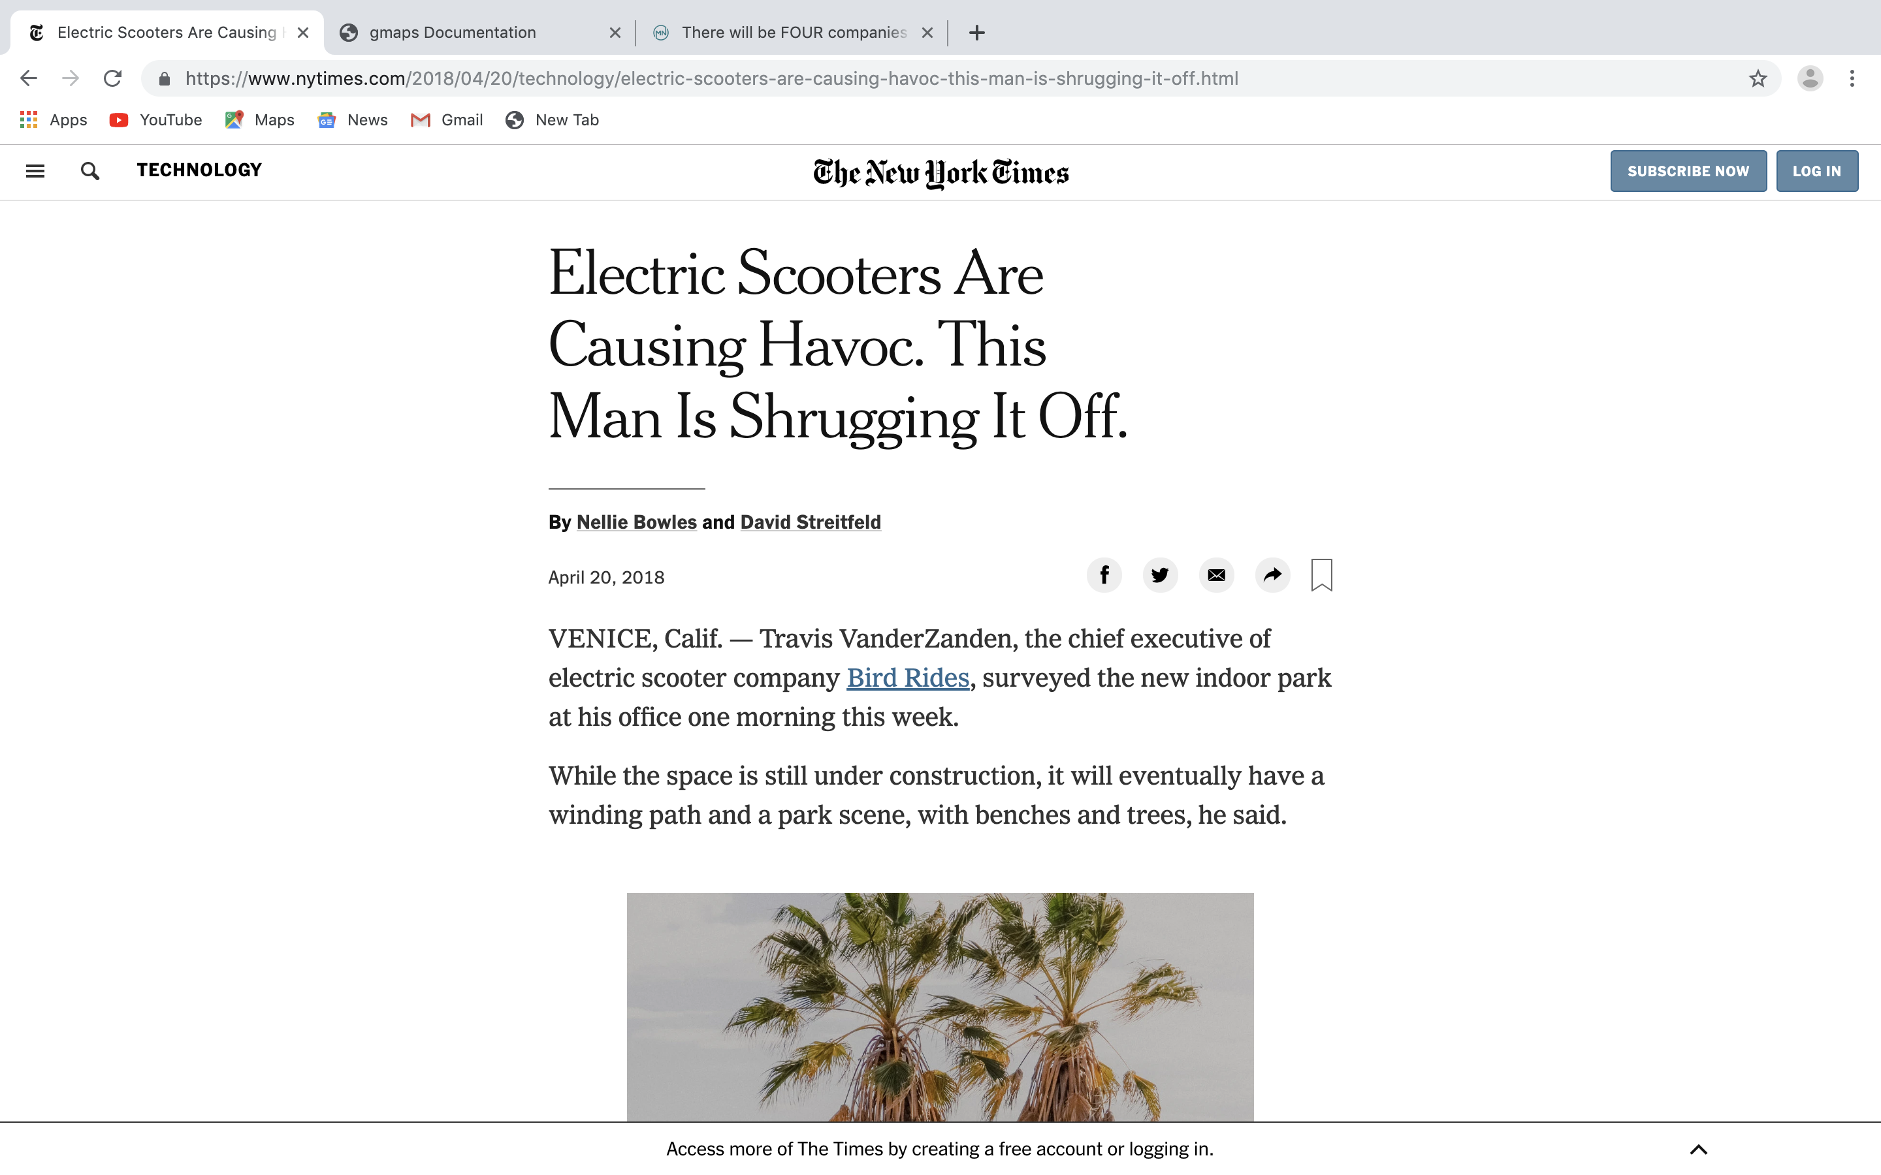
Why is this issue important?
Today, 126 US cities have “dockless” scooter operations
Reports from across the country indicate the nefarious rise in scooter crime
Minneapolis has recently approved dockless scooters

Slide 3
Summary of the study
Our hypothesis is that introduction of dockless scooters has increased the crime rate in Minneapolis.
We found crime data via www.minneapolisopendata.com????, and scooter rental data via www.scooterdata.com????
We determined the relationship between the rate of individual crimes and scooter rental data, and determine whether a correlation existed
Despite the seasonal effect on crime in Minneapolis, we were able to eliminate this phenomenon to determine that petty crimes decreased during the 4 month scooter pilot study.

Slide 4
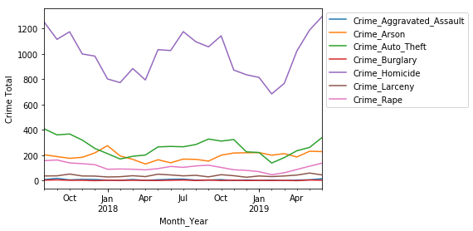
Time series of crimes
Additional test was carried on the Agg. Assault, Burglary, Arson and robbery.

Slide 5
The proximity to scooters and crime
Does the presence of scooters increase crime rate?
Determine scooter geolocation for start and end trips using Minneapolis scooter data (pilot program: July 10 – November 30, 2018) and Centerline data
Determine crime rate and neighborhood location using Minneapolis crime data
Elaborate on the questions you asked, describing what kinds of data you needed to answer them, and where you found it, and how you cleaned it

Slide 6
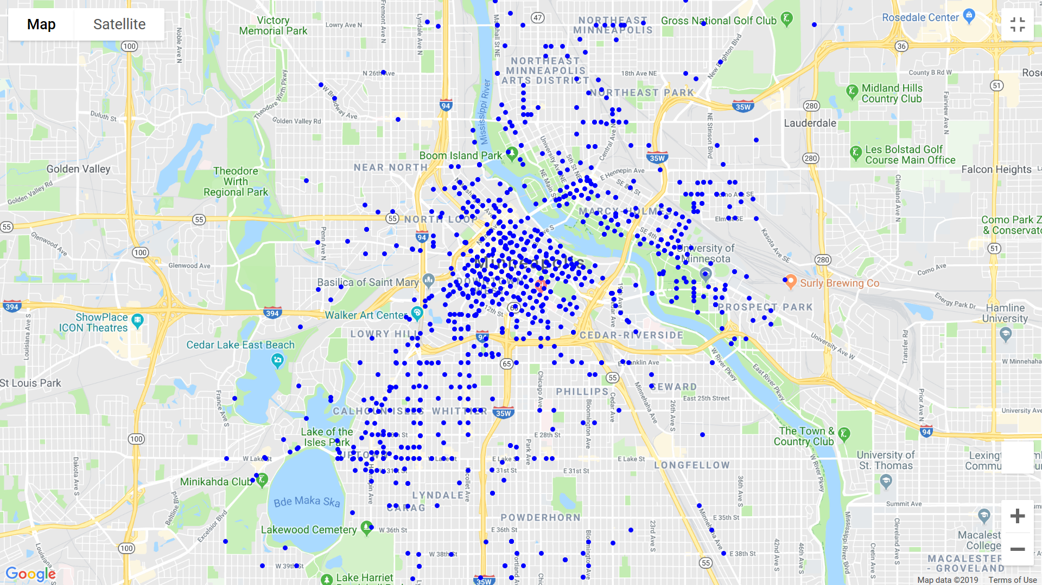
Scooter locations

Slide 7
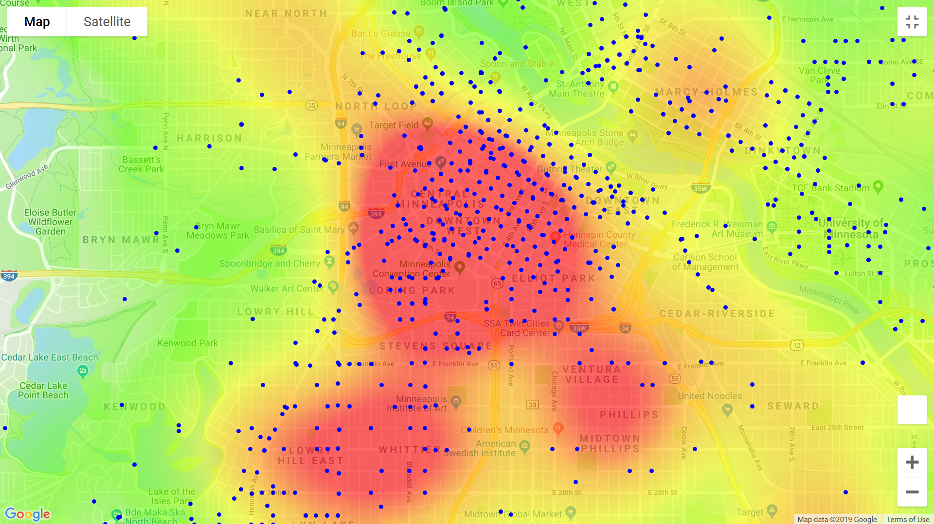
Crime rate and scooters

Slide 8
The seasonal effect on crime in Minneapolis
Firstly a time graph to provide a story line for our hypothesis
A summarized bar chart of all the crimes committed in neighborhood to show if there where increase or decrease and if it was caused by the introduction scooter to Minneapolis
Elaborate on the questions you asked, describing what kinds of data you needed to answer them, and where you found it, and how you cleaned it

Slide 9
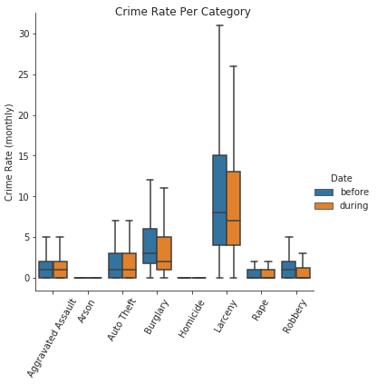
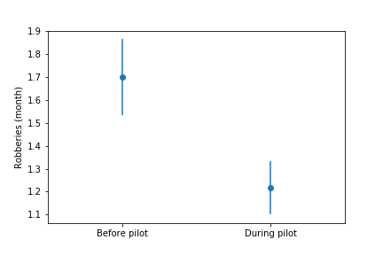
Digging into the numbers
Adding a “Date” column to the datable to delineate whether the crime happened before or during the scooter trial period (data visualized via Seaborn factor plot (hue = “Date)
Using numpy ttest, four categories show significant decline (Robbery, AggAssault, Burglary and Arson)

Slide 10
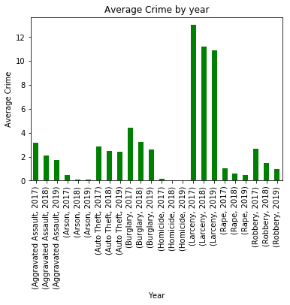
Discussion
We were surprised to find that our hypothesis turned out to be false
Crime actually decreased in four categories, which happen to be “less severe” crimes than the four that didn’t show any effect. And if measuring the crime rate by average crime committed monthly in Minneapolis across all neighborhood analyzed; crime decreased in all categories

Slide 11
Post Mortem
Access to clean data was hard
A lot of data cleansing was done to have a suitable data to work with.
Defining the scope of project and coming up with focused hypothesis.
Discuss any additional questions that came up, but which you didn't have time to answer: What would you research next, if you had two more weeks?

Slide 12
Questions?

